Slide 1



Capstone Project 1
Google Play Store App Review Analysis
Presented By:
TEAM- Scraper Nerds
Navneet Sawhney
Tinu J Pooppally
Biswanath Das
Manoj Chetry
Shubham V Jadav

Slide 2
What is Google Play Store and why Analyse it?
An online platform for downloading and purchasing mobile apps and games for Android devices.
It is the official app store for the Android operating system and is maintained by Google.
Google Play Store is one of the most popular app stores in the world, with over 2.9 million apps available for download as of 2021.
According to a study by App Annie, Google Play Store accounted for 85% of all app downloads globally in 2020. This is primarily due to the large market share of Android devices, which make up over 75% of the global smartphone market. (The state of mobile 2020 (2020). App Annie)
As per latest Google Play stats, there are 3.6 million apps currently at the Google Play Store. The number is constantly rising as around 3,739 apps are added to the Play Store every single day. ()

Slide 3
Problem Statement
To perform exploratory data analysis (EDA) on the Google Play Store in order to understand the trends and patterns in app downloads, user ratings, and revenue generated by apps with special focus on the medical category.

Slide 4
What is Exploratory Data Analysis (EDA)?
1
Data Collection
2
Initial
Hypothesis
3
4
Data Interpretation
Data Cleaning and Transformation
5
Data Visualisation
6
Testing Hypothesis

Slide 5
Columns /Attributes in Google Play store Dataset 1
The data set contains the following columns:
App: This Column contains the name of the Apps
Category: This contains the category to which the App belongs. The category column contains 33 unique values.
Rating: This column contains the average value of the individual rating the App has received on the Play store. Individual rating values can vary between 0 to 5.
Reviews: This column contains the number of people that have given their feedback for the App.
Size: This column contains the size of the app i.e. The memory space that the App occupies on the device after installation.
Installs: This column indicates the number of time that the App has been downloaded from the play store, these are approximate values and not absolute values.
Type: This column contains only two values- free and paid. They indicate whether the user must pay money to install the app on their device or not.
Price: For paid apps this column contains the price of the app, for free apps it contains the value 0.
Content Rating: It indicates the targeted audience of the app and their age group.
Genre: This column contains to which genre the app belongs to, genre can be considered as a sub division of Category.
Last updated: This column contains the info about the date on which the last update for the app was launched.
Current version: Contains information about the current version of the app available on the play store.
Android version: Contains information about the version of the android OS on which the app can be installed.

Slide 6
Columns /Attributes in User Review Dataset 2
User Reviews Dataset has 64295 rows and 5 columns. The 5 columns are identified as follows:
App: Contains the name of the App.
Translated Review: It contains the English translation of the review dropped by the user of the App.
Sentiment: It gives the attitude/emotion of the writer. It can be ‘Positive’, ‘Negative’, or ‘Neutral’.
Sentiment Polarity: It gives the polarity of the review. Its range is [-1,1], where 1 means ‘Positive statement’ and -1 means a ‘Negative statement’.
Sentiment Subjectivity: A value from 0 to 1 indicating the subjectivity of the review. Lower values indicate the review is based on factual information, and higher values indicate the review is based on personal or public opinions or judgement.

Slide 7
Point of discussion
Number of Apps per category
The top categories on Play Store based on the rating. and the RATING attribute
Application that has the highest number of user engagement in the category which has the highest number of applicants.
Count of applications in each category differentiated by their type.
Top 10 apps in any category based on their install count.
Optimal App Size
Percentage of free apps over paid apps? Also Checks the distribution of Content Rating
Does the application rating affect its user engagement
Distribution of apps updated over the Month
Android version based on each category
Type of sentiment dominates the most
Genre has the most positive
Genre has the most negative reviews
Distribution of sentiment within the different genres
The distribution of setiment_Subjectivity
Sentiment_Polarity within the different genres
Sentiment_Subjectivity proportional to Sentiment_Polarity

Slide 8
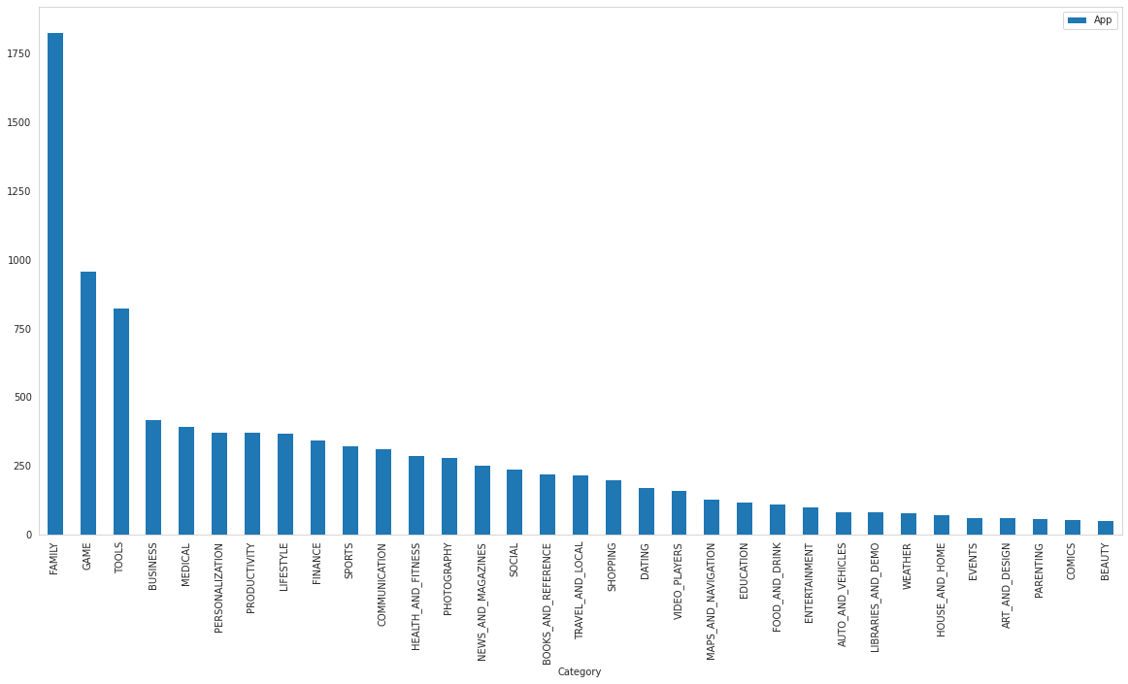
Number of Apps per category
The above bar graph represents the distribution of several apps in different categories in the Play Store. It can be inferred that FAMILY Category has the maximum number of Apps.

Slide 9
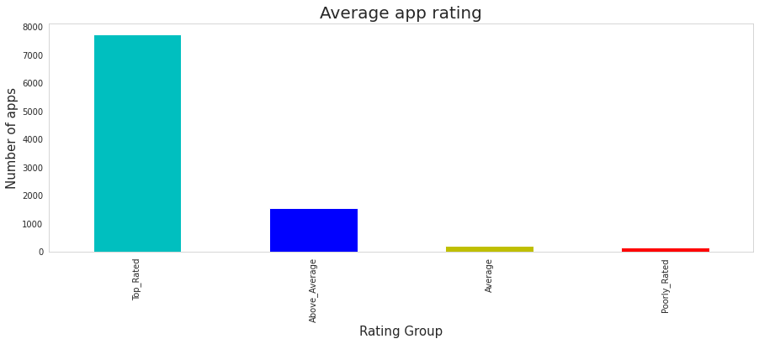
The top categories on Play Store based on the rating. and the RATING attribute
From the above analysis, we can conclude,
For all the categories, the average rating is above 4 stars.
Most of the Apps are "Top_Rated" as we can see in the above visualization.
The Average App Rating

Slide 10
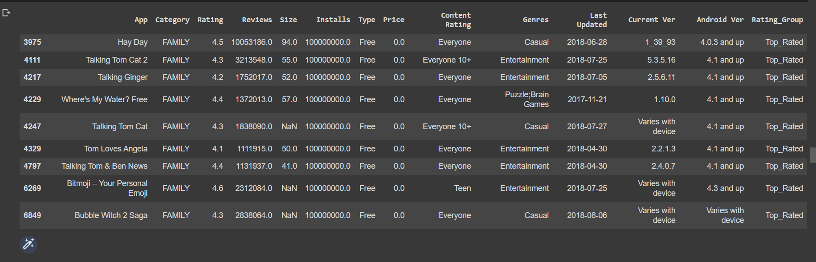
An application that has the highest number of user engagement in the category which has the highest number of applicants.
We already know that the 'FAMILY' category has the highest number of application
Highest number of installs belong to the free app as expected. Among the lowest number of installs which is zero, most of the apps belong to a paid version of the app.

Slide 11
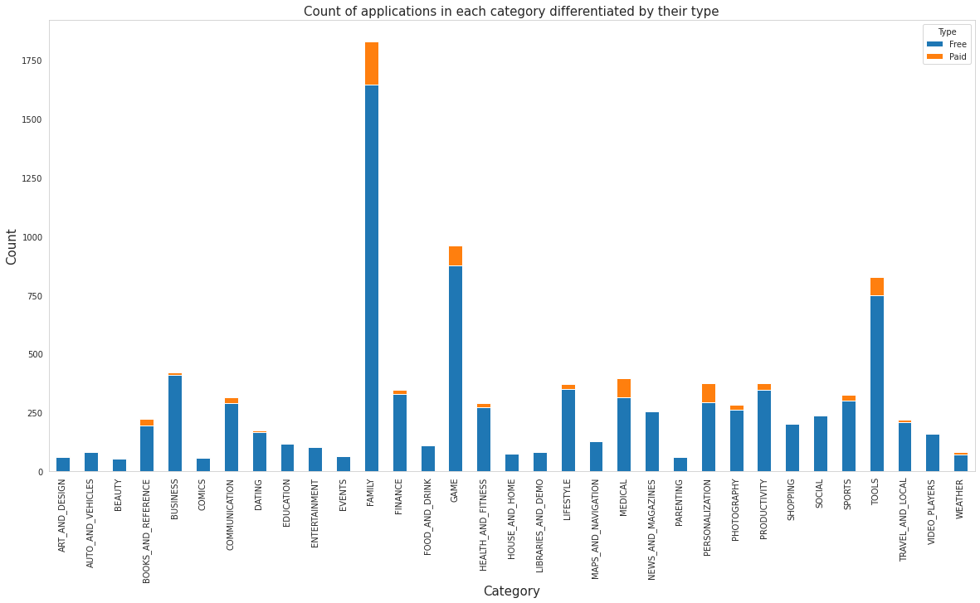
Count of applications in each category differentiated by their type.
It can be inferred that certain app categories have more free apps available for download than others. In our dataset, the majority of apps in Family, Games, and Tools, as well as Social categories are free for users to install.

Slide 12
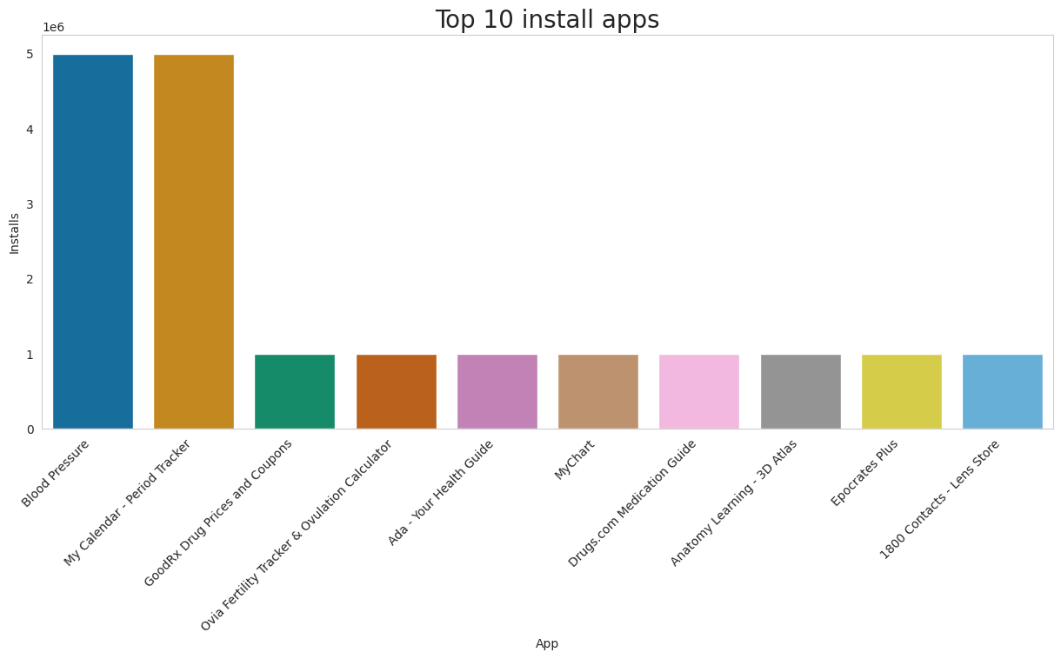
Top 10 Medical apps in any category based on their install count.
We can see the top 10 Medical Category apps in the above visualization.

Slide 13
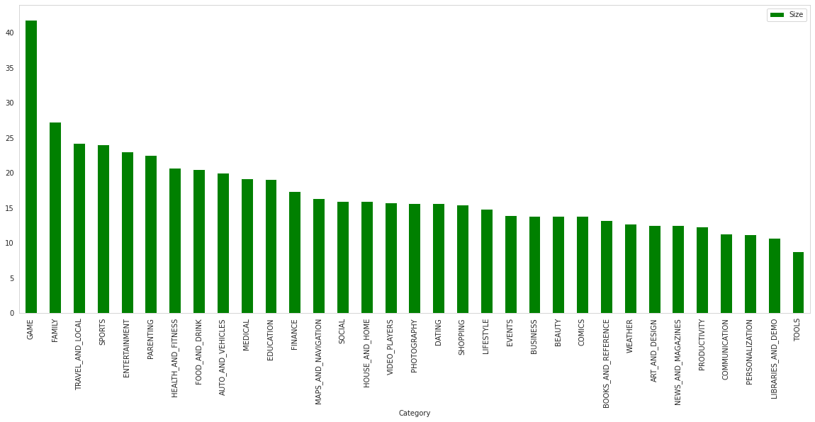
Optimal App Size
The average App Size is in the range of 10-25 Mb.
The Game category has the maximum average App Size.
Tools has the least average App Size.
The average App Size of the Medical category stands at 19 Mb.

Slide 14
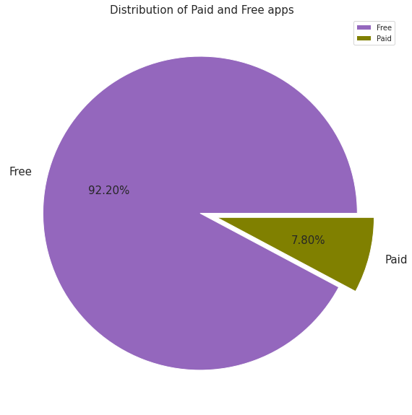
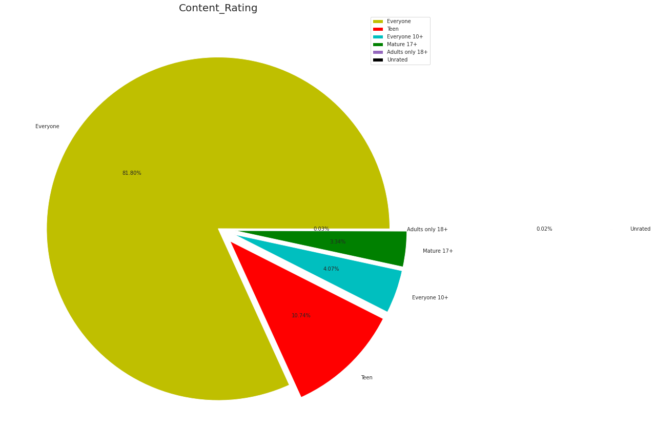
Percentage of free apps over paid apps? Also Checks the distribution of Content Rating
It can be inferred that around 92% of Apps are free and 8% of apps are paid. | As per the above pie chart, around 82% of Apps are created for Everyone the least are Unrated i.e. 0.02 followed by adults only 18+ i.e. 0.03.

Slide 15
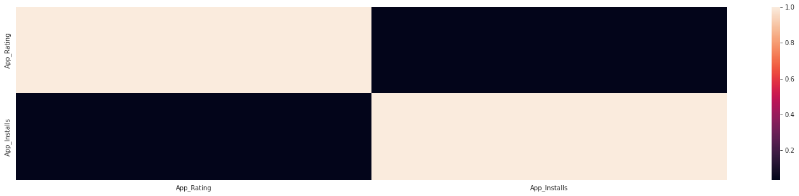
Does the application rating affect its user engagement
The linear correlation coefficient of approximately 0.039 suggests that there is no appreciable linear correlation.

Slide 16
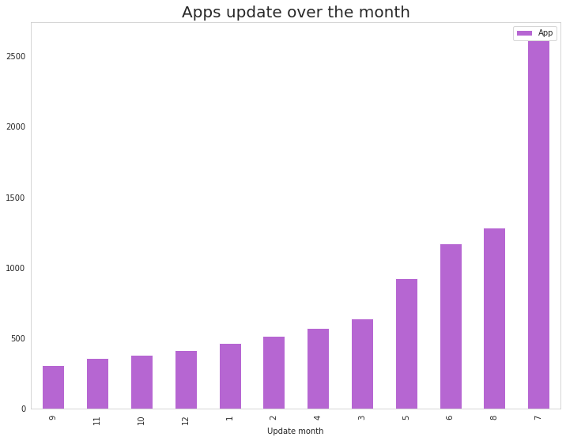
Distribution of apps updated over the Month
It can be inferred that the month of July records the highest App updates whichares followed by August and June showing that the majority of the updates happen in the middle of the year.

Slide 17
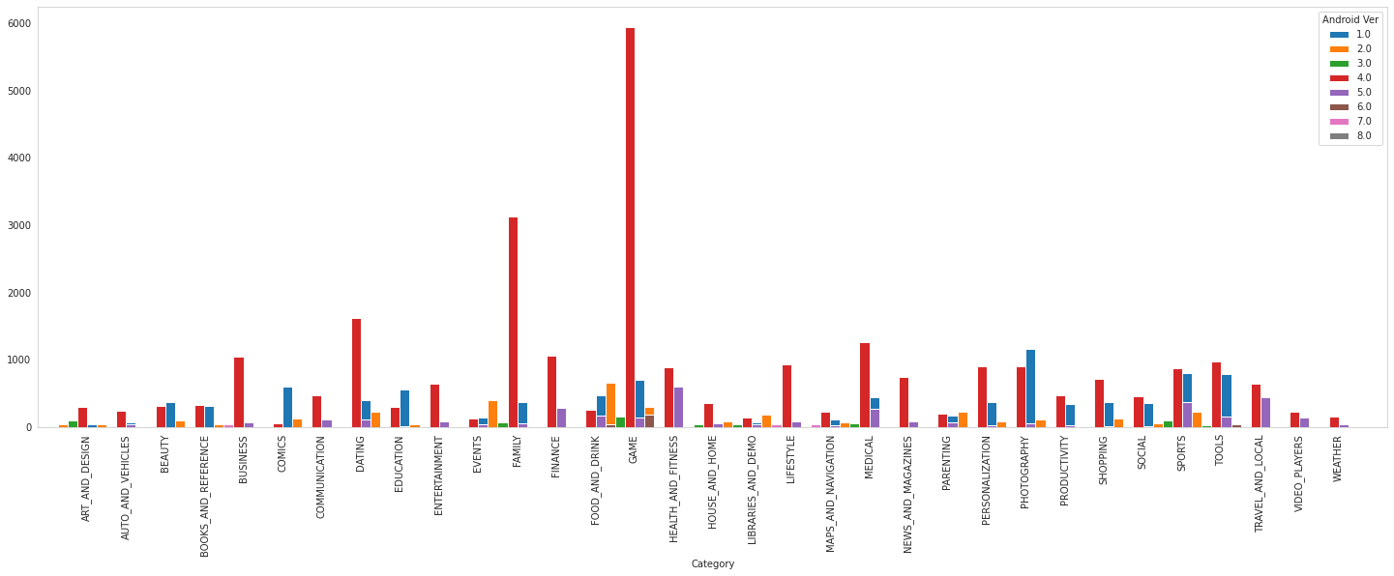
Android version based on each category
It is evident from the above plot that the majority of the apps are working on Android_Ver 4.0 and up.

Slide 18
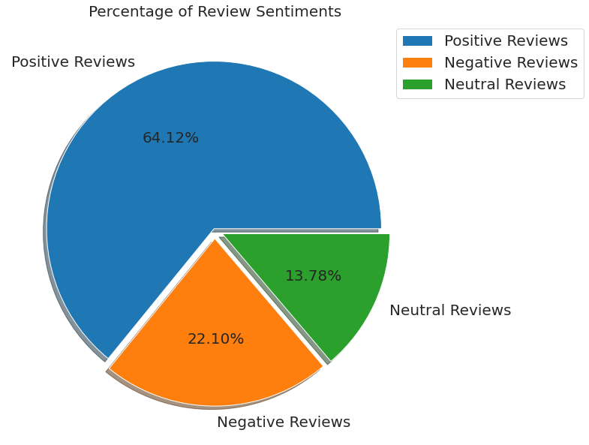
Type of sentiment dominates the most
Among all the reviews the positive reviews dominate the most with a share of 64.12%.
This is followed by negative reviews with a share of 22.10%.
3. least number of reviews are neutral reviews with a share of 13.78%.

Slide 19
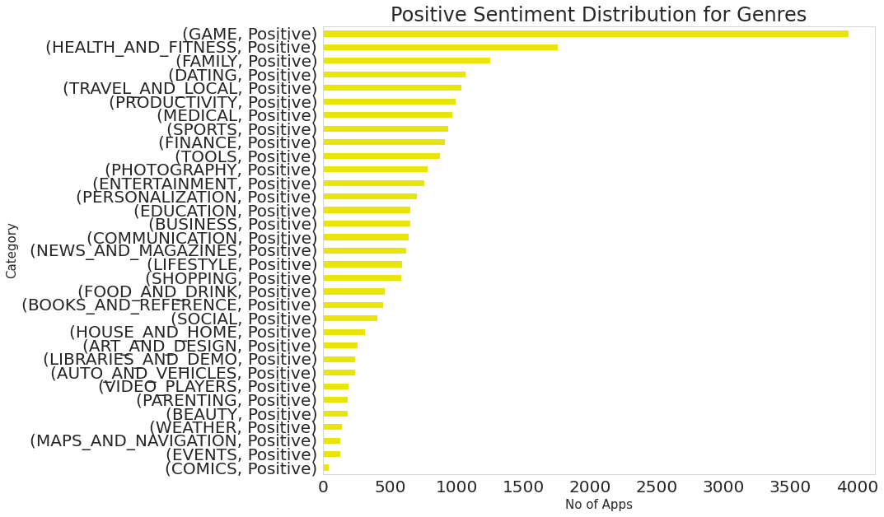
The genre has the most positive
It is likely that the game genre has the most positive reviews in the Play Store, as games tend to be highly engaging and entertaining for users. With more than 3900+ positive reviews
The Health and fitness genre of apps on the Play Store has the second-highest number of positive reviews. With 2400+ positive reviews
The Family genre of apps on the Play Store has the third-highest number of positive reviews. With 1500+ positive reviews
Comics genre of apps on the Play Store has the lowest number of positive reviews with less than 50

Slide 20
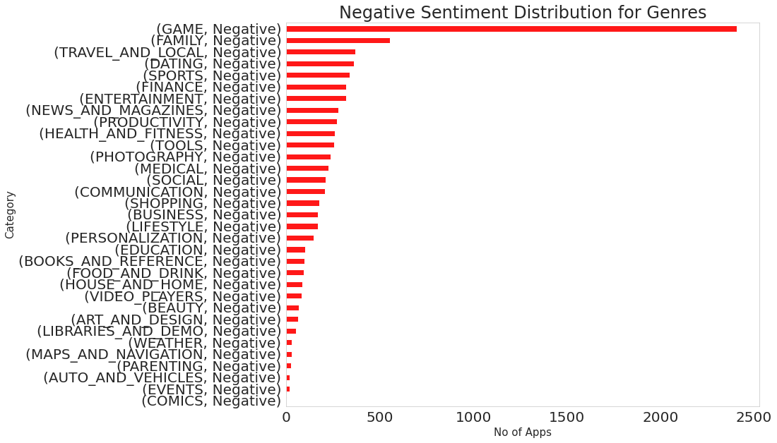
Genre has most negative reviews
The game genre may have the most negative reviews in the Play Store due to the high level of competition and the high expectations of users for gaming content. Additionally, games are often purchased or downloaded, which may lead to a higher rate of dissatisfaction among users who have spent money on a product that does not meet their expectations. With 2400+ negative reviews
The Family genre of apps on the Play Store has the second-highest number of negative reviews. With 600+ negative reviews
Travel and local genres of apps on the Play Store have the third-highest number of negative reviews. With 500 negative reviews
Comics genre of apps on the Play Store has the lowest number of negative reviews with less than 50 reviews

Slide 21
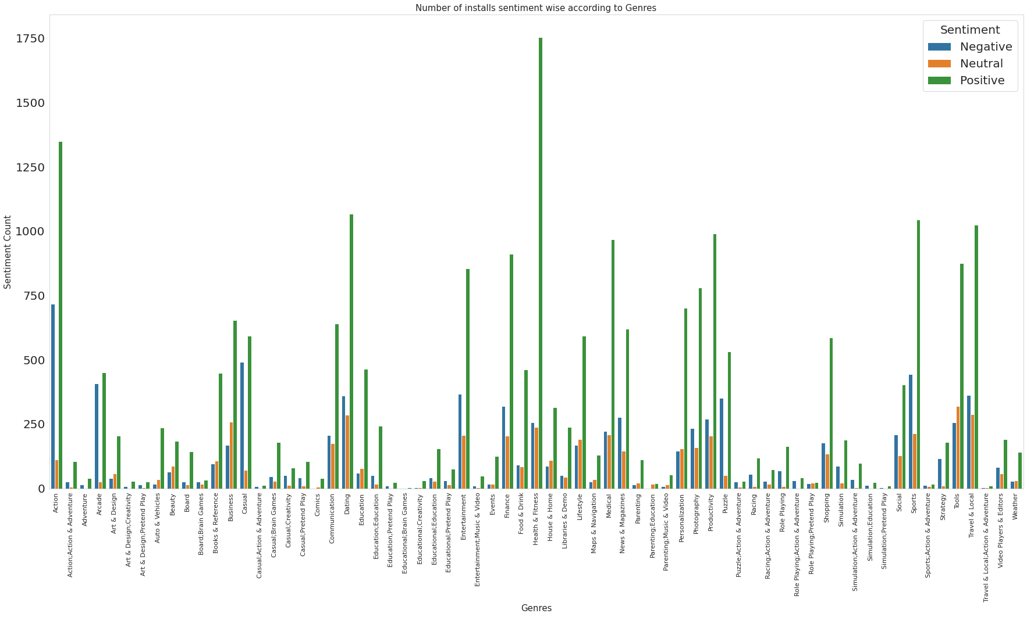
Distribution of sentiment within the different genres
It can be seen that Health and Fitness have the highest number of positive reviews which is followed by Action. But it is also worthwhile to note that Action has the highest number of negative reviews as well while the ratio is much less for Health and Fitness.

Slide 22
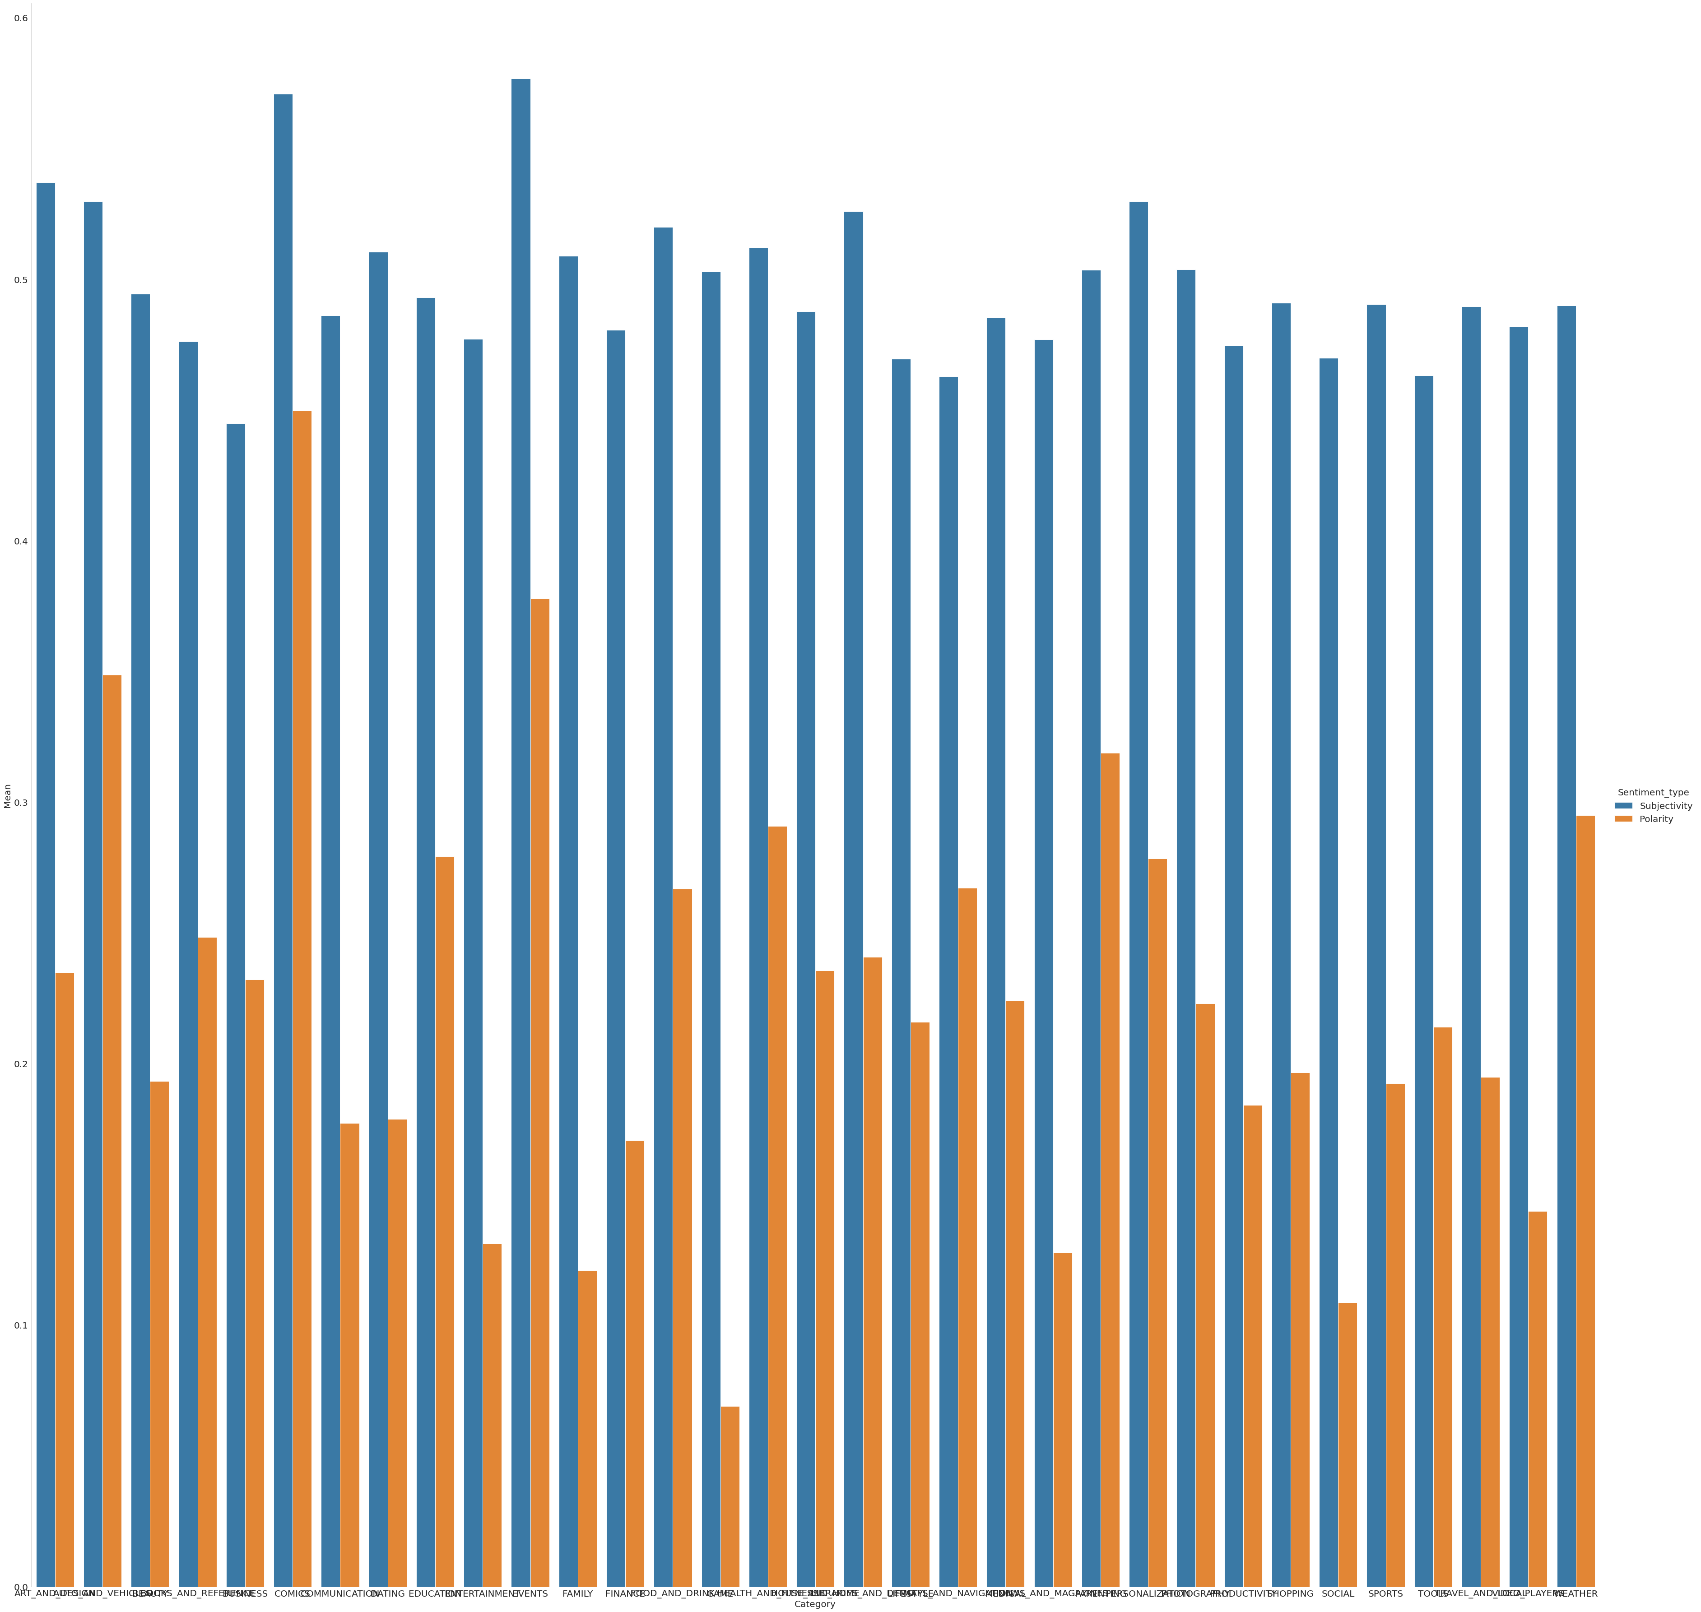
The distribution of sentiment Subjectivity

Slide 23
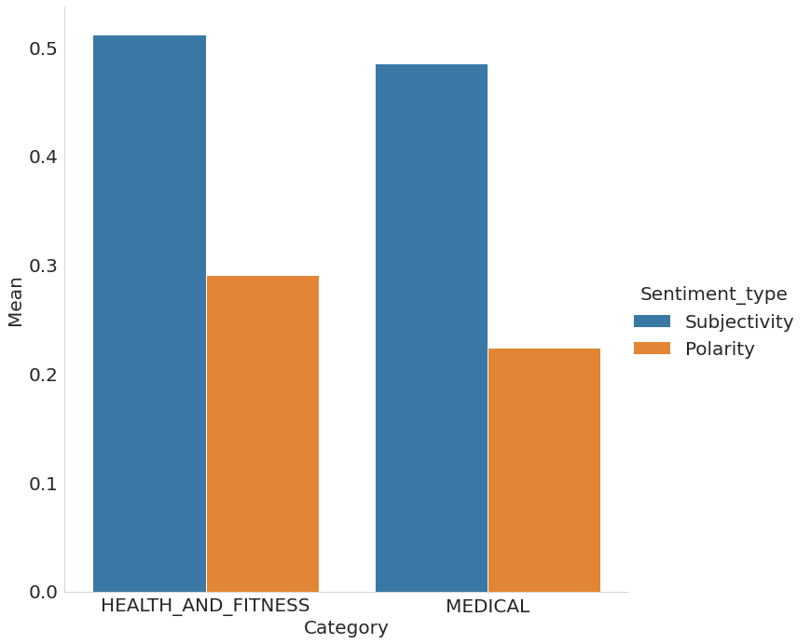
Sentiment Polarity within the different genres

Slide 24
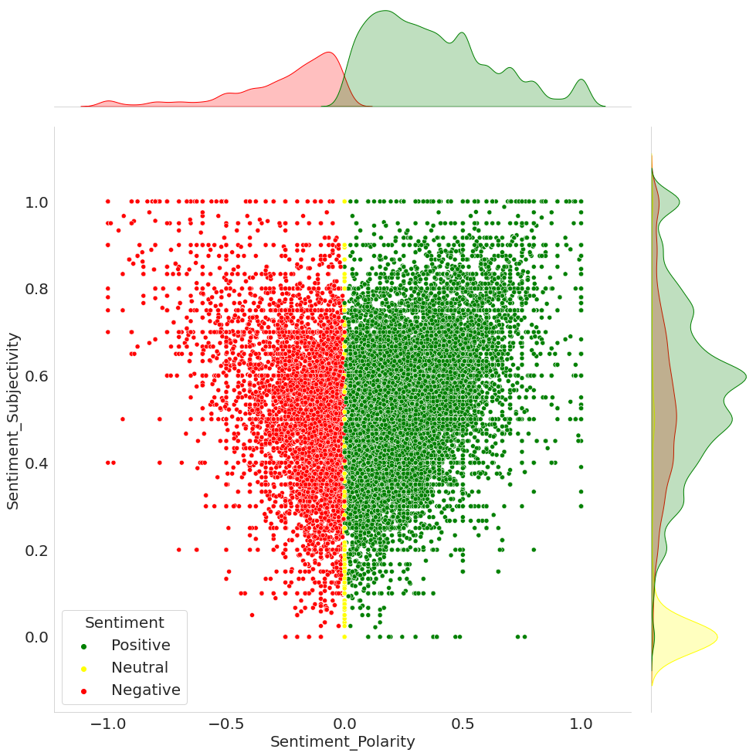
Sentiment Subjectivity proportional to Sentiment Polarity
From the above scatter plot, it can be concluded that sentiment subjectivity is not always proportional to sentiment polarity but in a maximum number of the case, shows a proportional behavior, when variance is too high or low.

Slide 25
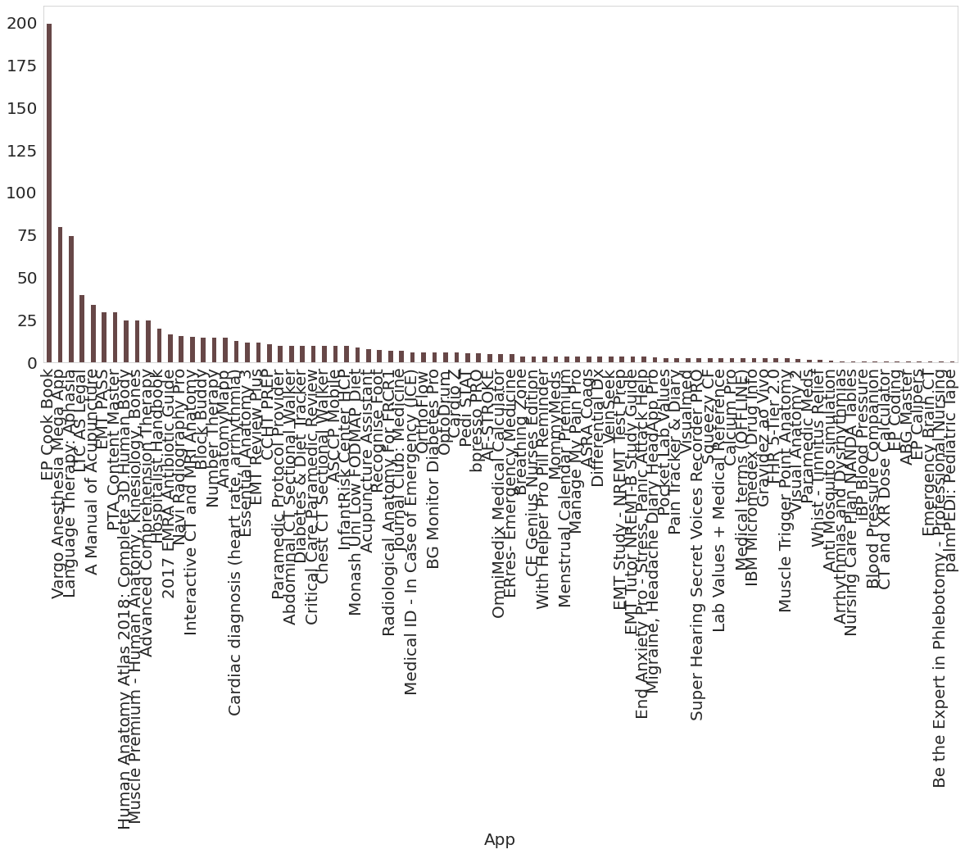
Avg price of paid apps on Medical
Paid medical apps on the Google Play Store typically offer additional features and functionality not found in the free version. Some examples include advanced diagnostic tools, detailed explanations of medical conditions, and personalized treatment plans.
We can see on a bar chart EP Cook Book is the most expensive app and its Avg price is about 200$
And the second most expensive app is Vargo Anesthesia Mega App and its Avg price is about 75$
After seeing a bar char we can say that most of the paid medical apps’ prices are below 50$

Slide 26
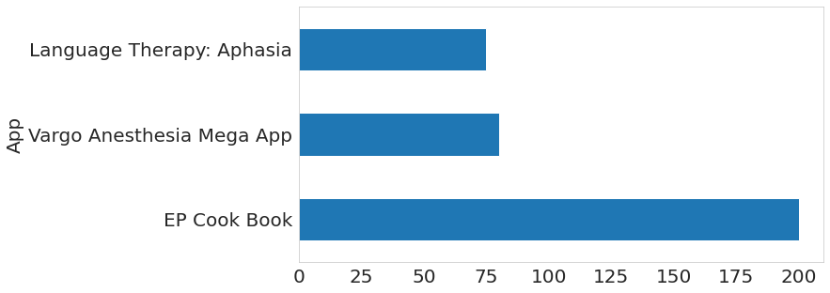
Avg price of top 3 paid apps on Medical
We can see on the bar chart EP Cook Book is the most expensive app and its Avg price is about 200
And the second most expensive app is Vargo Anesthesia Mega App and its Avg price is about 75$
Language Therapy: Aphasia is the third paid app that has 73$ price

Slide 27
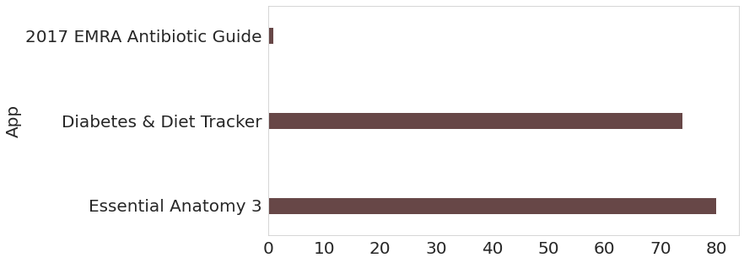
top 3 paid medical apps

Slide 28
Conclusion
The app's name should accurately describe its value propositions. because the majority of successful applications have this quality.
Launching the apps in the category which has more and easy user reach such as ”FAMILY”, ”GAME” etc.
As per our analysis most of the apps are free it’s around 92%, so if possible try to launch the app with the "Free" type. as it increases user engagement.
We also see that the number of installs is correlated with the rating of the application as the number of installs increases so as the application rating.
One important inside we get concerning the size of the app is that as the size of the application increases the installation of the app decrease. So, if we release a new app in the market make sure it's under 20MB.
Content rating also affects user engagement; the more restricted your content rating is, the more restricted your user engagement. So try to keep the user rating as "Everyone".
Make sure the app will get the update at regular intervals, as it’s an important factor for user engagement and the performance of the application. In our analysis, we have seen that most apps will get their app update in July.
As we have seen from subjectivity, most of the reviews are objective, So for successful apps, it's more important to keep an eye on the user reviews and early resolution of the problems.
We also see from our analysis that there is a strong relationship between Install and reviews. for new apps reviews are an important tool for increasing user engagement.
For the apps it’s more important to have android version compatibility above version 4.
It can be seen that Health and Fitness have the highest number of positive reviews which is followed by Action.

